Slide 1

— Data science Project —
Logistic Regression With Python
Group 1
Data Set: Titanic ( Kaggle)
Swayam Mehta

Slide 2
Tables of Contents
Introduction
EDA
Data Cleaning
Dummy Variables
Logistic regression
Confusion Matrix
01
02
03
04
05
06

Slide 3

INTRODUCTION

Slide 4
Importing Libraries
These are the libraries we will be u for regression model.
import pandas as pd -Dataset Library
import numpy as np - MultiDimensional Array Library
import matplotlib.pyplot as plt - Numerical Visualization Library
import seaborn as sns - Statistical Graphic Library
%matplotlib inline - Inline Plotting

Slide 5
Importing Dataset
Now we import the titanic_train dataset using pandas inbuilt function; read_csv
df_train= pd.read_csv('titanic_train.csv')
We create a new pandas dataframe called df_train that contains the dataset.

Slide 6
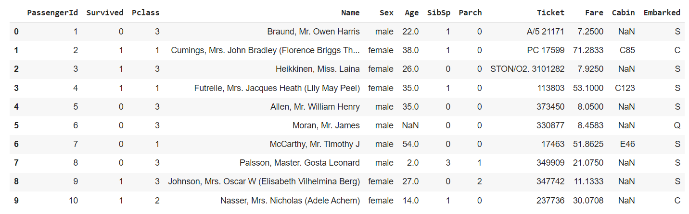
First 10 rows of Training Data

Slide 7
EXPLORATORY DATA ANALYSIS

Slide 8
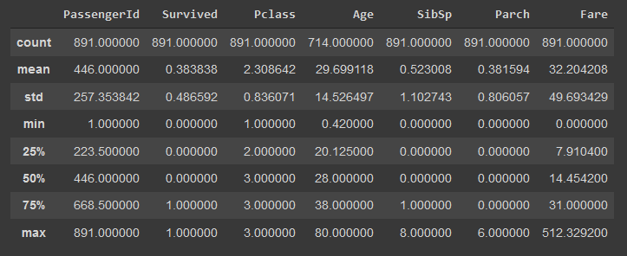
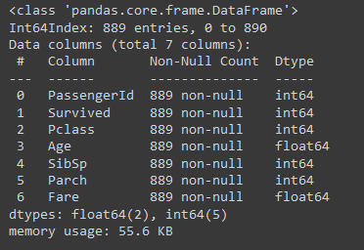
Info and describe methods on df_train

Slide 9
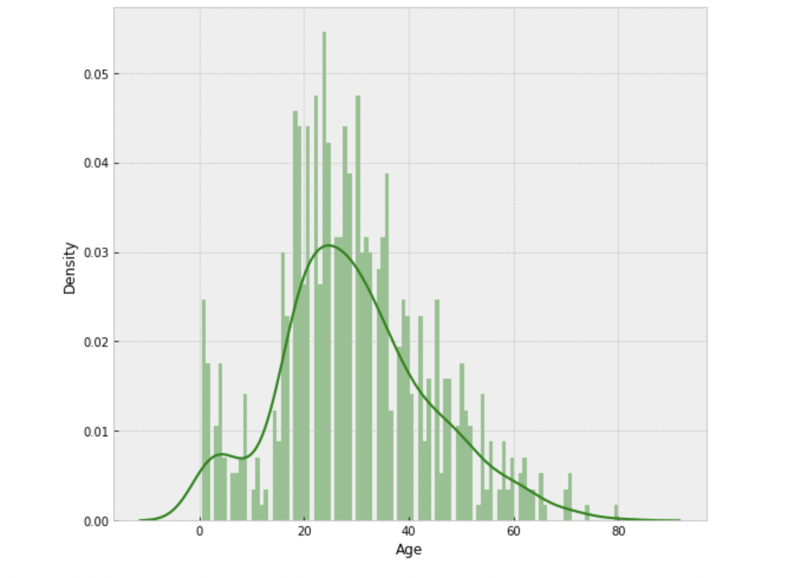
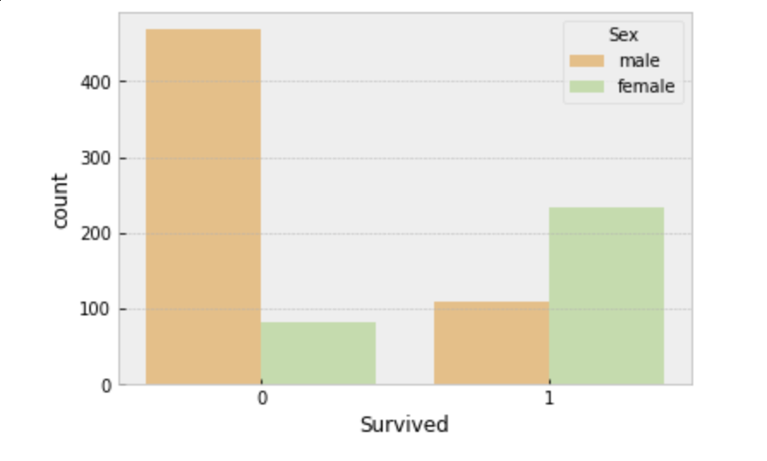
Exploratory Data Analysis
Density of Age distribution
Survived by genders

Slide 10
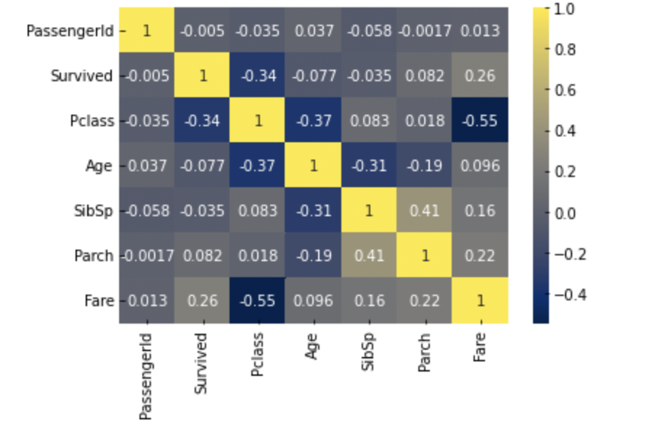
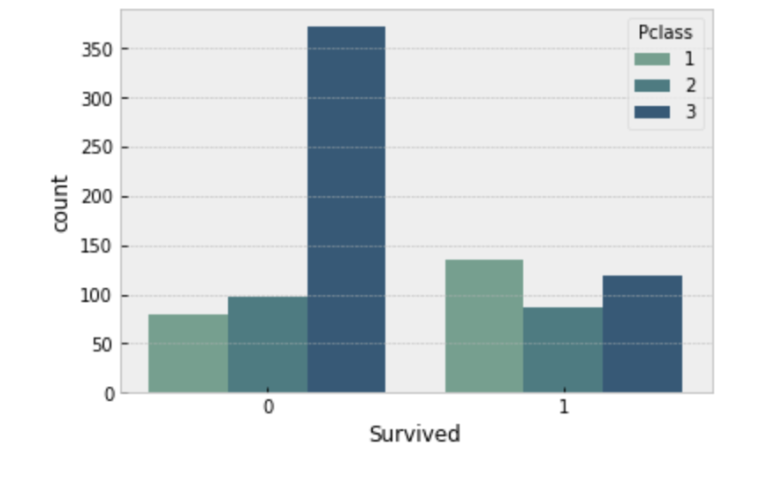
Explore data - Virtualization
Heatmap - correlation matrix
Bar chart of survived by Pclass

Slide 11
DATA CLEANING

Slide 12
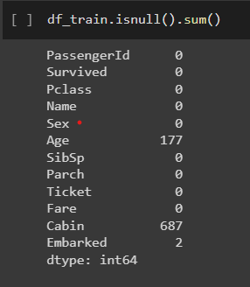
Check the missing data
Code:
isnull(): check if the data is null
sum(): count the total null data
We can see that the number of missing values
In age - 177,
Cabin - 687 and
Embarked - 2

Slide 13
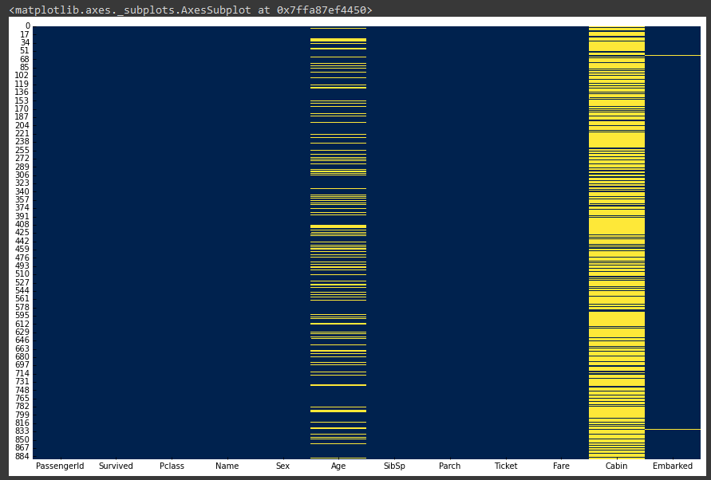
Missing Data Visualization
Creating a simple heat map to see where the missing data is present in the data set.
plt.figure(figsize = (20,10))
sns.heatmap(df_train.isnull(), cbar=False, cmap='cividis')

Slide 14
Filling the null values in AGE
Approximately 20% of the Age data is missing. The fraction of Age missing is mostly minimal enough to be replaced reasonably with some type of approximation.
df_train['Age'] =
df_train['Age'].groupby([df_train['Pclass']]).apply(lambda x:x.fillna(x.mean()))

Slide 15
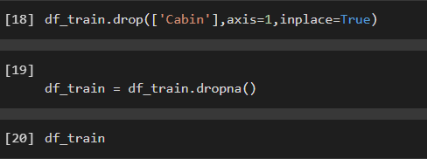
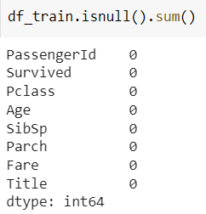
Drop the Cabin column
Drop column Cabin from the dataframe
axis = 1 ( drop column)
Remove the missing value in ‘Embarked’ from the data frame

Slide 16
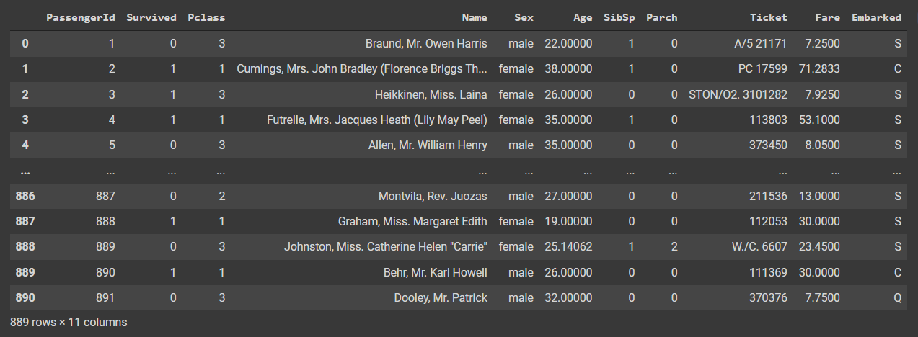
Output :

Slide 17
Feature Engineering - Name
We have categorized Name, to a new column - “Title” with following conditions:
All male titles as 0
All female titles as 1
And all gender neutral titles as 2
This type of feature engineering is categorical encoding.
df_train['Title']=df_train['Name'].str.extract('([A-Za-z]+)\.',expand=False)
title_mapping = {"Mr": 0, "Miss": 1, "Mrs": 1,"Master": 0, "Dr": 2, "Rev": 2, "Col": 2, "Major": 2, "Mlle": 1,"Countess": 1,"Ms": 1, "Lady": 1, "Jonkheer": 0, "Don": 0, "Dona" : 1, "Mme": 1,"Capt": 2,"Sir": 0 }
df_train['Title'] = df_train['Title'].map(title_mapping)

Slide 18
Feature Engineering - Fare
df_train.loc[df_train['Fare'] <= 17, 'Fare'] = 0
df_train.loc[(df_train['Fare'] > 17) & (df_train['Fare'] <= 30), 'Fare'] = 1
df_train.loc[(df_train['Fare'] > 30) & (df_train['Fare'] <= 100), 'Fare'] = 2
df_train.loc[ df_train['Fare'] > 100, 'Fare'] = 3
We categorized the fare according to its price
This type of feature engineering is discretization.
Observation - Some ticket numbers are identical, the reason for this could be
Either because they are family members
or , because of some manual error

Slide 19
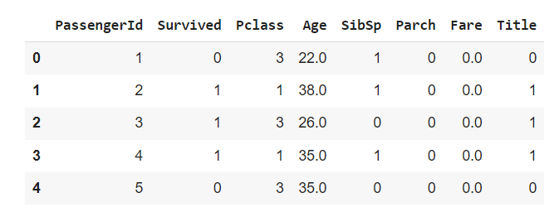

Slide 20
DUMMY VARIABLES

Slide 21
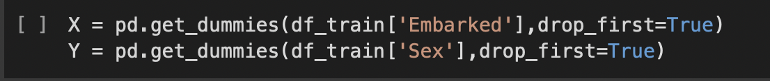
Handling Categorical Data
Before we can run our logistic regression we have to deal with the categorical data in the dataset such as Sex & Embark
We use pandas’ inbuilt get_dummies() function which assigns a numerical value to each category in the Sex & Embark columns.

Slide 22
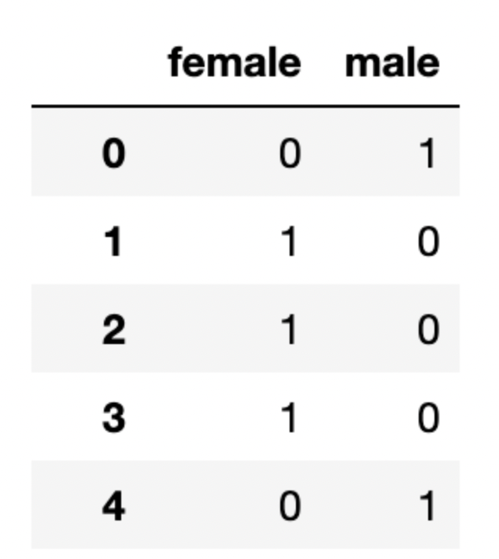
The get_dummies() function creates a new column for every value in a given column,hence why we set drop_first=True, so that the first column is dropped leaving us with only the “male” column. However, this gives us a great advantage which reduces the multicollinearity for the regression
The Sex column consists of two values; Male/Female and the Embark column consists of three values which indicates the city the passenger is from.

Slide 23
Logistic Regression

Slide 24
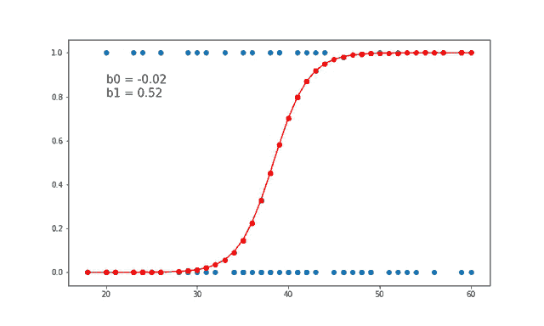
What is Logistic Regression ?
A classification is logistic regression. It predicts a binary outcome based on a collection of independent factors.
It assists us in estimating the likelihood of falling into a specific level of the categorical answer given a collection of predictors.
It is also a Machine Learning method used for classifying aspects, as well as a predictive analytic method based on the concept of probability.

Slide 25
Libraries used:
The sklearn library contains a lot of efficient tools for machine learning and statistical modeling including classification, Logistic Regression, clustering and dimensionality reduction.
from sklearn.model_selection import train_test_split
Importing the Logistic regression class to perform the model and make an instance of the Model
from sklearn.linear_model import LogisticRegression
LR = LogisticRegression()

Slide 26
Splitting and Making a Model
The code below performs a train test split which puts 70% of the data into a training set and 30% of the data into a test set. This is to make sure that our classification algorithm is able to generalize well to new data.
x_train, x_test, y_train, y_test = train_test_split(x , y, test_size = 0.3,random_state=3)
Make an instance of the Model
LR = LogisticRegression()
LR.fit(x_train, y_train)
Training the model on the data, storing the information learned from the data. Model is learning the relationship between digits (x_train) and labels (y_train)

Slide 27
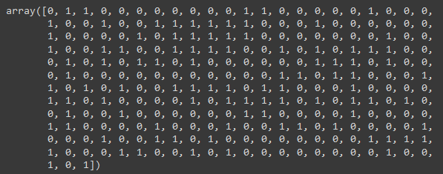
Output (Predicted value)
Predict labels for new data (new images) by using the information the model learned during the model training process
Predicted_Value = LR.predict(x_test)
Predicted_Value
The output:

Slide 28
Confusion Matrix

Slide 29
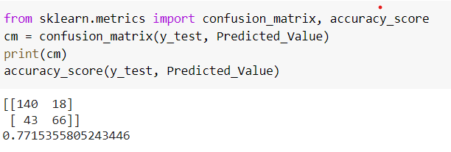
Analyze Confusion Matrix
What percent of predictions were correct?
(TN + TP)/(TP+FP+FN+TN) = 0.771
77%
Type 1 error is higher than Type 2 error.
FN < FP implies recall will be higher than precision.
 | Actual + Class | Actual - Class
Predicted - Class | True Positive TP = 140 | False Negative FN=18
Predicted - Class | False Positive FP = 43 | True Negative TN=66
accuracy

Slide 30
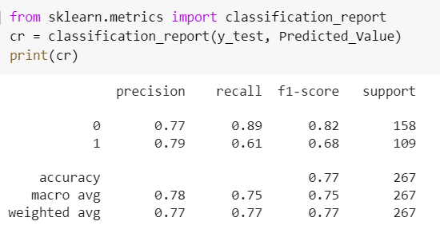
Analyze Classification Report
What percent of the positive cases did you catch?
Recall = TP/(FN+TP) = 0.886 89%
What percent of positive predictions were correct?
Precision = TP/(TP+FP) = 0.765 77%
Optimal blend of precision and recall?
F1 score = 2*(Pre*Rec)/(Pre+Rec) = 0.825 82%
Macro avg is the average of precision/recall/f1-score
Ex. on precision =0.77+0.79/2 = 0.78 78%
Weighted avg is the weighted avg of them
Ex. on precision = 165/267∗pre1+ 102/267∗pre2=0.77
Precision < Recall
* Support is the number of samples
of the true response that lie in that class.

Slide 31
THANK YOU!

